Slide 1
ABUSIVE LANGUAGE DETECTION ON SOCIAL MEDIA
By Rajkumar Pal
For Masters in Machine Learning and Artificial Intelligence,
at Liverpool John Moores University

Slide 2
Introduction/Background
The history of Abusive Language Detection goes way back to the rise of social media or even back to the rise of the email era. Many things we see now on social media were started with emails.
In this modern era as time progresses, we’re moving into the digital era. Now the internet has become more important than food, people can live a day without food but not the internet. With an increase in usage of the internet crime, abusiveness, bullying and hate speech have also increased all over the internet (Ayo et al., 2020) and parents wouldn’t want their children to learn this from the internet which they will eventually learn, the truth be told but not before time.
Social media provides a forum for people to communicate their opinions, expertise, experiences, and feelings, but it becomes a serious issue when these interactions are used as a vehicle for abusive statements, comments, and dialogues. Racism, sexism, and other ideologies may all be promoted through the use of abusive language.
Machine Learning can assist us with taking care of issues that were troublesome or incomprehensible previously, and abusive language detection is one of them. We want social media to be a safer environment for everyone, so we’re taking the first step toward that goal and Machine learning is our most effective weapon against it.

Slide 3
Problem statement
Text classification and abusive language detection are not something new, there are methods involving doing several monolingual operations on. Abusive language detection is a difficult task that requires a lot of machine learning and pattern recognition algorithms.
The detection is not always accurate and sometimes, it can be wrong and result in false positives. There are many challenges such as detecting slang, sarcasm, screaming, long sentences and many others.
Specific items are designated as offensive text if they are intended to be defamatory, humiliating, or insulting. In contrast to assaulting text, abusive material is typically targeted toward social classes such as gender, religion, handicap, sexual orientation or towards ethnic origin.
The majority of these methods rely on pre-trained text classification models. The great bulk of research on this topic focuses on English, in part because English-language resources are more widely available. Recently studies were done on different languages including Greek, Arabic, Dutch, Danish, French, Portuguese, Italian, Turkish and Slovene which lead us to additional datasets and tools for the above languages which can be further used to narrow down research on a particular language of choice. (Anand et al., 2022)

Slide 4
Literature review
To prevent the use of abusive languages, many social media companies have standards guidelines that every users must adhere to, as well as using human editors in coupling with technologies that leverage blacklists and regular expressions to detect and eliminate inappropriate posts. As individuals increasingly converse online, the demand for high-quality automatic abusive language classifiers grows rapidly (Nobata et al., 2016; Silva et al., 2016).
Abusive language can be quite grammatical and fluent. Well there are a numerous examples of abusive language being rather loud on the internet, such as “Add anotherJEW fined a bi$$ion for stealing like a tiny grub.”, “Hang thm all”, which could be a useful signal for an automated system, there are numerous instances where abusive language, or particularly hate speech, is highly grammatical and fluent. For instance, “I’m amazed they reported on this nonsense; who cares about another dead nigger?”. Sarcasm is another source of uncertainty in abusive language identification.
There are instances where some individuals would submit humorous remarks in the same tone as others who were using abusive language. This situation is extremely difficult for people or machine learning algorithms to accomplish right since it necessitates knowledge about the community and maybe even the users themselves: “since I am disabled and must stay at home. I despise Jews because they ran over my legs with their BMW, so I’m going to bomb them every day with my posts.”, “I’m cripple but I can destroy them with my posts.”, “I’m a chicken, so I can post behind Yahoo’s anonymous poster wall.”, “I’m going to give him ten thumbs down and insult Jews. Bwbwbwbahahahah...I’m Hitler reborn.” (Nobata et al., 2016).

Slide 5
Related works in English language
The separation of hate speech from other instances of objectionable language is of significant difficulty for automatic hate-speech detection on social media. Lexical detection approaches have poor accuracy since they identify all communications containing certain phrases as hate speech, and earlier work employing supervised learning failed to differentiate between the two classifications (Davidson et al., 2017). They gathered tweets containing hate speech terms using a crowd-sourced hate speech lexicon. They employed crowdsourcing to classify a sample of these tweets into three categories: those having “hate speech”, those containing “offensive language”, and those featuring neither. They trained multi-class classifiers to differentiate between these various groupings. A closer inspection of the prediction models and mistakes reveals when they can consistently distinguish hate speech from other offensive words and when this distinction is more difficult. They discovered that racist and homophobic tweets are more likely to be labelled as hate speech, but sexist tweets are more likely to be classified as offensive. Tweets that lack clear hateful words are likewise more difficult to categorise (Davidson et al., 2017).

Slide 6
For online social media, automatic abusive language identification is a challenging though critical job. Their study contrasts a two-step technique of conducting classification on abusive language and then classifying it into particular categories with a one-step procedure of completing a single multi-class classification for identifying sexist and racist languages. With a public English Twitter corpus of 20 thousand tweets including sexism and racism, our technique achieves a promising F-measure of 0.827 using HybridCNN in one step and 0.824 using Logistic Regression in two phases (Park and Fung, 2017).
As the number of studies on abusive language detection and evaluation expands, there is an increasing need for critical examination of the links between the many subcomponents that have been classified under the term abusive language. Based on the research on hate speech, cyberbullying, and online abuse, (Waseem et al., 2017) suggested a typology that reflects the key similarities and distinctions across subcomponents and addresses the consequences of data annotation and characteristic generation. They stress the practical steps that scholars may take to a better approach in their abusive language detection subtask.

Slide 7
(Zhang et al., 2018)’s study describes a new strategy that is based on a deep neural network that combines convolutional and gated recurrent networks. They conducted a thorough assessment of the method against many of the benchmarks and state of-the-art on the biggest collection of publicly released Twitter datasets to date, demonstrating that, especially in comparison to reported earlier results on these datasets, their suggested technique is capable of capturing both word sequence and order information in short texts.
The results and key conclusions of SemEval-2019 Task 6 on recognizing and categorising Offensive Language in Social Networks are presented (OffensEval) by (Zampieri et al., 2019b). The project was based on the “Offensive Language Identification Dataset (OLID)”, a new dataset containing around 14,000 English tweets. It has three subcomponents. The purpose of subcomponent A was to distinguish between offensive and non-offensive postings. The focus of subcomponent B was on the type of offensive content in the online posts. And, under subcomponent C, systems had to identify the intended recipient of the offending posts (Zampieri et al., 2019b).

Slide 8
A substantial corpus of research has been conducted on the automated detection of hate speech and associated issues. Cross-dataset model generalisation, on the other hand, remains a difficulty. Throughout this setting, we discuss two still unanswered crucial questions: (i) to what degree does generalisation rely solely on the model and the composition and annotation of the training data in terms of different categories? And (ii) do particular features of datasets or models impact generalisation possibilities? To answer (i) they conducted intra- and crossdataset experiments with BERT, ALBERT, fastText, and SVM models trained on nine standard public English datasets with standardized and comparable. The tests reveal that generalization differs between models and that some categories (for example, ‘toxic’ ‘abusive’, or ‘offensive’) work better as cross-dataset training categories than others (for example, ‘hate-speech’). To respond to (ii), they employed the Random Forest model to evaluate the importance of various model and dataset variables in predicting the performance of 450 BERT, 450 ALBERT, 450 fastText, and 348 SVM binary abusive language classifiers (1698 in total). They discovered that in order to generalise effectively, a model must first perform well within an intra-dataset. Furthermore, several other characteristics, including the training and goal categories, as well as the fraction of out-of-domain vocabulary, are similarly important for the success of generalisation (Fortuna et al., 2021).

Slide 9
Because of the fast growth of online social media, Abusive Language Detection (ALD) has become a trendy topic in the area of affective computing. However, most ALD approaches in social networks ignore the interaction links between user postings, instead seeing ALD as a challenge of text context representation learning. To address this issue, we suggest a pipeline method that considers both the scope of a post and the features of the interaction network within which it is published. Our technique is split into two components: pre-training and downstream tasks. To begin, we employ Bidirectional Encoder Representation from Transformers (BERT) as an Encoder to construct phrase reconstructions in order to capture subtle contextual characteristics of the postings. Later, we construct a Relation-Special Network utilising the semantic relation of posts and the structural information from the interaction network. Upon that premise, they develop a Relation-Special Graph Neural Network (RSGNN) to effectively deliver information in the interaction network and learn text categorization. The experiment shows that their strategy can significantly enhance the identification of abusive posts across three public datasets. The results indicate that introducing interaction network structure into the abusive language detection task improves detection outcomes considerably (Song et al., 2022).

Slide 10
Related works in non-English language
According to the number of speakers worldwide, Hindi is the third most spoken language in the world. It has been spoken by millions of Indians and has grown in complexity and usage as a result of varied geographical impacts and linguistic preferences. While “Hinglish” (Hindi written in the Roman script rather than the original Devanagari) is widely used online, the number of native Hindi speakers writing in Devanagari is increasing. Despite this, there have been few studies conducted on the usage of Hindi as an internet language. Their study proposes a methodology that uses a fastText based model to differentiate and then categorise abusive text from non-offensive text. The algorithm was able to categorise text from a dataset of Devanagari Hindi Offensive Tweets (DHOT). A grid-search strategy was used to modify hyper-parameters during fastText, which revealed intriguing insights into model accuracy and precision. Our fastText model obtained 92.2% accuracy when processed on a desktop-class computer. To the best of our knowledge, this is the first attempt to create a cutting-edge categorization of abusive language in Hindi utilising fastText models (Jha et al., 2020).

Slide 11
(Sharma et al., 2022) proposed study focuses on analysing hate speech in a code-switched Hindi-English dialect. They investigated transformation strategies in order to obtain accurate text representation. They created “MoH”’ meaning (Map Only Hindi), The “MoH” pipeline includes language recognition, Roman to Devanagari Hindi transliteration utilising a knowledge base of Roman Hindi terms, and lastly the fine-tuned Multilingual Bert and MuRIL (Multilingual Representations for Indian Languages) language models. They performed many quantitative trial investigations on three datasets, measuring performance with Precision, Recall, and F1 measures. The first trial compares the performance of “MoH” mapped text with standard machine learning models and finds an average gain of 13% in F1 scores. The second measures up the proposed work’s scores against those of the baseline methods and finds a 6% performance improvement. Finally, utilising the current transliteration library, the third evaluates the suggested “MoH” approach to various data simulations. “MoH” surpasses the others by 15% in this case. Codemixing is a prevalent occurrence in social media writing, especially in multilingual nations like India. Traditional deep learning approaches learned on monolingual data do not work well enough on code-mixed data, and training the new models is difficult owing to resource constraints. Transforming multilingual data to monolingual is a critical solution to this problem. In this paper, TIF-DNN, a Transformer-based Interpretation and Feature Extraction Model, is suggested for hate speech classification. In our proposed model, we employed the IndicNLP and English To Hindi libraries for transliteration and translation, respectively, and mBERT for feature extraction.

Slide 12
(El-Alami et al., 2022) suggested research that would use transfer learning models and the fine-tuning phase to handle the Multilingual Offensive Language Detection (MOLD) challenge. They propose an efficient method based on Bidirectional Encoder Representations from Transformers (BERT), which has demonstrated tremendous promise in collecting semantics and contextual information inside texts. The suggested method is divided into three stages: (1) preprocessing, (2) text representation using BERT models, and (3) classification into two groups: offensive and non-offensive. To deal with multilingualism, they investigated several strategies such as joint-multilingual and translation-based ones. The first is to create a single categorization system for all languages, and the second is to translate all writings into a single global language and then categorise them. They ran numerous tests on a multilingual dataset derived from the Semi-supervised Offensive Language Identification Dataset (SOLID). The experimental results reveal that the translation-based technique combined with Arabic BERT (AraBERT) obtains an F1-score of 93% and an accuracy of over 91%.

Slide 13
Research methodology
Dataset Description:
The dataset which we are using here is the Twitter English tweets dataset, also known as the Davidson dataset, it is found in the Repository for the paper “Automated Hate Speech Detection and the Problem of Offensive Language”, ICWSM 2017. It is an English dataset with all the tweets in the English language. The dataset contains 24783 tweets, each tweet is either of hate speech or abusive language or neither as voted by the users of CrowdFlower. The dataset contains 5 columns and they are:
“count”: amount of individuals that coded each tweet on CrowdFlower (min is 3).
“hate_speech”: amount of users on CF who voted the tweet to be hate speech.
“offensive_language”: amount of users on CF who voted the tweet to be offensive.
“neither”: amount of users on CF who voted the tweet to be neither non – offensive nor offensive.
“class”: class label for majority of users on CF. 0 – hate speech 1 – offensive language 2 – neither.

Slide 14
Data Pre-processing:
Missing Value Treatment:
Handling missing values is the very first step in data pre-processing as there might missing values than might make our model inefficient and in many cases might result into error.
Feature Selection:
After handling missing values, we will remove the features that are not associated with offensive or abusive language detection or any feature that will not be useful in model training.
Text Cleaning:
Once we have removed the features that are not required the next step would be to convert all the tweets into small cases and after conversion removes unnecessary words that are irrelevant to our research i.e. removal of punctuations, user handles or mentions, hashtags (#) and emoticons.
Tokenization and Normalization:
We need to tokenize and customize our tweets so that it becomes feed able to our models and so that models can identify the underlying patterns in the tweets.
Handling Imbalanced Data:
Once we are done with all tokenization we also need to makes sure that the dataset is not imbalanced and to counter it we’ll do resampling i.e. oversampling or undersampling so that the model can learn about the each class properly without overfitting anyone class.

Slide 15
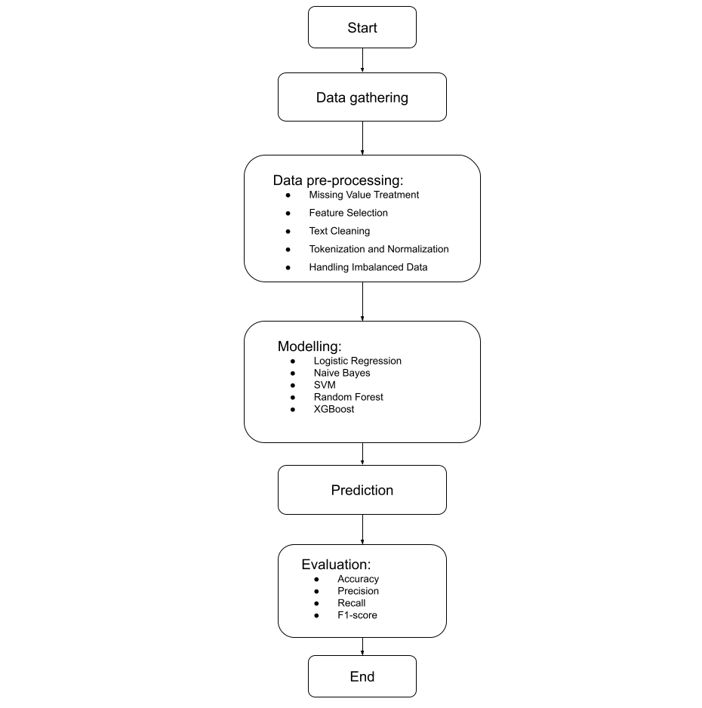
Modelling
In this study, our approach for the modelling will start with data gathering. Once we have the data the next step will be to clean it with pre-processing methods and analyse the data. Once the data is clean we can move to the next step by feeding our data to machine learning algorithms. Our approach for modelling will be to start from the bottom and move upwards i.e. to start from the basic model and then move on to complex models. The models used for this study were:
Logistic Regression
Naïve Bayes
Support Vector Machine
Random Forest
XGBoost

Slide 16
Evaluation
We can see that selecting the appropriate model is also crucially important. Testing models on a dataset provides important information on the quality of the dataset in a nascent research field like abusive language detection, where so much subjectivity still remains. The evaluation metrics we will use in our study to evaluate the performance of our models are:
Accuracy: The probability of correctly classified abusive tweets from the total number of tweets present.
Precision: It is the probability of the predicted abusive tweets that were actually labelled as abusive.
Recall: It is the probability of abusive tweets correctly predicted as abusive tweets.
F1-score: The F1-score combines a classifier’s precision and recall into a single statistic by calculating their symmetrical mean.

Slide 17
Results and discussions
Model | Accuracy (%) | Precision (%) | Recall (%) | F1-Score (%)
Logistic Regression | 90.38 | 75.17 | 69.92 | 70.94
Logistic Regression (undersampling) | 80.30 | 80.04 | 80.30 | 80.04
Logistic Regression (oversampling) | 90.65 | 90.62 | 90.65 | 90.60
Logistic Regression (TF-IDF) | 89.13 | 89.09 | 89.13 | 89.07
Naïve Bayes | 84.34 | 84.48 | 84.34 | 84.36
Naïve Bayes (TF-IDF) | 83.32 | 83.43 | 83.32 | 83.35
Support Vector Machine | 91.45 | 91.49 | 91.45 | 91.41
Support Vector Machine (TF-IDF) | 90.36 | 90.40 | 90.36 | 90.30
Random Forest | 80.47 | 81.22 | 80.47 | 79.81
Random Forest (TF-IDF) | 40.79 | 71.92 | 40.79 | 31.09
XGBoost | 87.32 | 87.28 | 87.32 | 87.16
XGBoost (TF-IDF) | 41.72 | 69.12 | 41.72 | 32.68

Slide 18
Conclusions and future works
Conclusion:
We found out that the Support Vector Machines (SVM) performed better than any other models we tried, and with low resource Logistic Regression performed slightly behind SVM, to counter data imbalance we found over-sampling worked better than under-sampling, we also tested with TF-IDF transformation, we got better results with non TF-IDF transformed data, and the ensemble methods performed worst with TF-IDF transformed data
Future Works:
In this study, we used Logistic Regression, Naïve Bayes, Support Vector Machine Classifier, Random Forest Classifier and XGBoost Classifier, we didn’t use any of the Hugging Face BERT models or Deep Learning models, so there a clear opportunity to use those model and see how well they perform on the dataset also with the time we also need to change the dataset to newer dataset as people will pull new tricks from their bag so from time to time we need to retrain our models with the newer dataset which contains newer slangs.

Slide 19
references
Ayo, F.E., Folorunso, O., Ibharalu, F.T. and Osinuga, I.A., (2020) Machine learning techniques for hate speech classification of twitter data: State-of-the-art, future challenges and research directions. Computer Science Review, 38, p.100311.
Anand, M., Sahay, K.B., Ahmed, M.A., Sultan, D., Chandan, R.R. and Singh, B., (2022) Deep learning and natural language processing in computation for offensive language detection in online social networks by feature selection and ensemble classification techniques. Theoretical Computer Science, p.S0304397522003887.
Nobata, C., Tetreault, J., Thomas, A., Mehdad, Y. and Chang, Y., (2016) Abusive Language Detection in Online User Content. In: Proceedings of the 25th International Conference on World Wide Web. [online] WWW ’16: 25th International World Wide Web Conference. Montréal Québec Canada: International World Wide Web Conferences Steering Committee, pp.145–153. Available at: https://dl.acm.org/doi/10.1145/2872427.2883062.
Silva, L., Mondal, M., Correa, D., Benevenuto, F. and Weber, I., (2016) Analyzing the Targets of Hate in Online Social Media. Available at: http://arxiv.org/abs/1603.07709.
Davidson, T., Warmsley, D., Macy, M. and Weber, I., (2017) Automated Hate Speech Detection and the Problem of Offensive Language. Available at: http://arxiv.org/abs/1703.04009.
Park, J.H. and Fung, P., (2017) One-step and Two-step Classification for Abusive Language Detection on Twitter. In: Proceedings of the First Workshop on Abusive Language Online. [online] Proceedings of the First Workshop on Abusive Language Online. Vancouver, BC, Canada: Association for Computational Linguistics, pp.41–45. Available at: http://aclweb.org/anthology/W17-3006.
Waseem, Z., Davidson, T., Warmsley, D. and Weber, I., (2017) Understanding Abuse: A Typology of Abusive Language Detection Subtasks. In: Proceedings of the First Workshop on Abusive Language Online. [online] Proceedings of the First Workshop on Abusive Language Online. Vancouver, BC, Canada: Association for Computational Linguistics, pp.78–84. Available at: http://aclweb.org/anthology/W17-3012.

Slide 20
Zhang, Z., Robinson, D. and Tepper, J., (2018) Detecting Hate Speech on Twitter Using a Convolution-GRU Based Deep Neural Network. In: A. Gangemi, R. Navigli, M.-E. Vidal, P. Hitzler, R. Troncy, L. Hollink, A. Tordai and M. Alam, eds., The Semantic Web, Lecture Notes in Computer Science. [online] Cham: Springer International Publishing, pp.745–760. Available at: http://link.springer.com/10.1007/978-3-319- 93417-4_48.
Zampieri, M., Malmasi, S., Nakov, P., Rosenthal, S., Farra, N. and Kumar, R., (2019b) SemEval-2019 Task 6: Identifying and Categorizing Offensive Language in Social Media (OffensEval). In: Proceedings of the 13th International Workshop on Semantic Evaluation. [online] Proceedings of the 13th International Workshop on Semantic Evaluation. Minneapolis, Minnesota, USA: Association for Computational Linguistics, pp.75–86. Available at: https://www.aclweb.org/anthology/S19-2010.
Fortuna, P., Soler-Company, J. and Wanner, L., (2021) How well do hate speech, toxicity, abusive and offensive language classification models generalize across datasets? Information Processing & Management, 583, p.102524.
Song, R., Giunchiglia, F., Shen, Q., Li, N. and Xu, H., (2022) Improving Abusive Language Detection with online interaction network. Information Processing & Management, 595, p.103009.
Jha, V.K., P, H., P N, V., Vijayan, V. and P, P., (2020) DHOT-Repository and Classification of Offensive Tweets in the Hindi Language. Procedia Computer Science, 171, pp.2324–2333.
Sharma, A., Kabra, A. and Jain, M., (2022) Ceasing hate with MoH: Hate Speech Detection in Hindi–English code-switched language. Information Processing & Management, 591, p.102760.
El-Alami, F., Ouatik El Alaoui, S. and En Nahnahi, N., (2022) A multilingual offensive language detection method based on transfer learning from transformer fine-tuning model. Journal of King Saud University - Computer and Information Sciences, 348, pp.6048–6056.

Slide 21
Thank you

